Slide 1

Heart Disease Prediction by using Machine Learning
By
Nibedita Das 700734268
Siri Vennela Namburu 700733139
Thandarupalli Naveen Goud 700734683
Tadishettysachit Kumar 700734682
Ganugapanta Rama Krishna Reddy 700735138
This Photo by Unknown author is licensed under CC BY-ND.
This Photo by Unknown author is licensed under CC BY-ND.

Slide 2
Problem statement
The project involved analysis of the heart disease patient dataset with proper data processing.
Then, different models were trained, and predictions are made with different algorithms KNN, Decision Tree, Random Forest, Logistic Regression etc.
This is a classification problem, with input features as a variety of parameters, and the target variable as a binary variable, predicting whether heart disease is present or not.
Machine Learning algorithms used:
Logistic Regression (Scikit-learn)
K-Nearest Neighbours (Scikit-learn)
Decision Tree (Scikit-learn)
Random Forest (Scikit-learn)
Neural Network ( Keras and tensorflow)

Slide 3
Software requirements
1. Python ( Programming language)
Packages used
1. Pandas
2. NumPy
3. scikit-learn 4. Matplotlib
5.tensorflow
6.keras
Input :
Historical data of heart disease patients
Output :
Binary variable, predicting whether heart disease is present or not

Slide 4
3 approaches to train a model
Supervised learning
Unsupervised learning
Reinforcement learning
Supervised learning:
This algorithm consist of a target / outcome variable (or dependent variable) which is to be predicted from a given set of predictors (independent variables).
Unsupervised learning:
In this algorithm, we do not have any target or outcome variable to predict / estimate.
Reinforcement algorithms:
It is nothing but it is AI
Using this algorithm, the machine is trained to make specific decisions. It works this way: the machine is exposed to an environment where it trains itself continually using trial and error. This machine learns from past experience and tries to capture the best possible knowledge to make accurate business decisions

Slide 5
Machine Learning Life cycle for heart disease prediction
start
Machine learning for Heart disease prediction
Input data (age , sex , cp , trestbps, chol, fbs, thalach , exchangh etc.)
Yes ( Since Data set has label whether patient suffered with heart disease or not)
Is labelled data
No
Supervised Learning
Unsupervised Learning
No( Binary 0 – no heart disease 1- heart disease)
Is labelled data is continuous
Yes
KMeans
classification
Regression
Linear regression , Random forest regrssor and many other
DBScan
Final model selection
stop

Slide 6
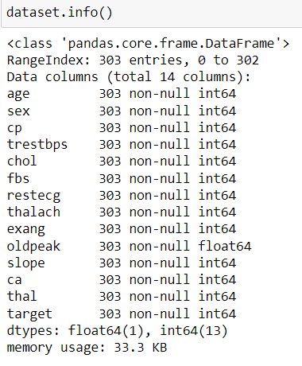
Exploratory Data analysis
Analyzing whether data contains any null values
From below code observed that there are no null values in any feature

Slide 7
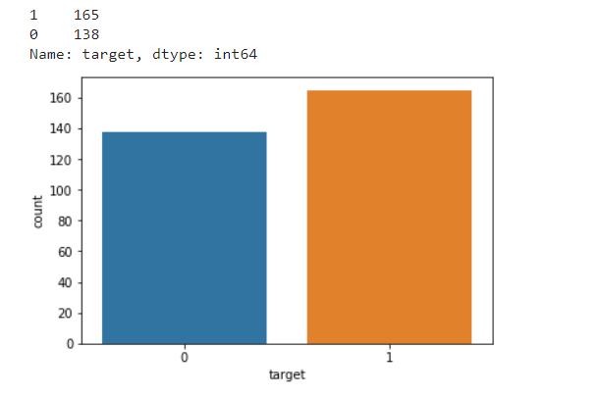
Exploratory Data analysis
Analysing the target variable:
In the given data set there 165 patients with heart disease and 138 patients with no
heart disease , below bar graph shows distribution of patients

Slide 8
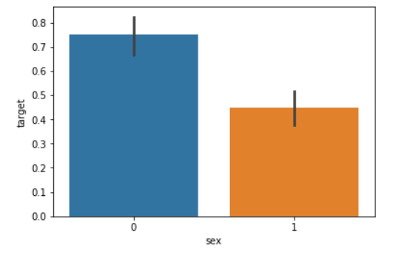
Analyzing gender wise details
0- Female , 1-Female
From the graph is noticed, that females are more likely to have heart problems than
males

Slide 9
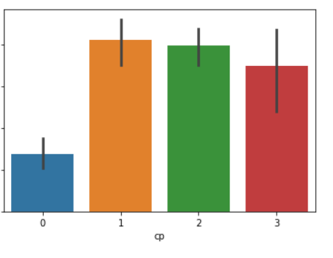
Analyzing chest pain
From below graph noticed, that chest pain of '0', i.e. the ones with typical angina
are much less likely to have heart problems

Slide 10
Data sets used in machine learning:
Trainset
Validation set (optional)
Test set
Trainset:
It is used to train models
Test set:
Used for evaluating model (accuracy testing)
Validation set:
Optional (Deeper evaluation of model)
Every model designed required at least 2 data sets train and test set. Train set is
used to train the model , once the model is designed test set is used to test the
model and to confirm whether it is working fine or not

Slide 11
Divide the heart disease data set into train and test set :
from sklearn.model_selection import train_test_split
predictors = dataset.drop("target",axis=1)
target = dataset["target"]
X_train,X_test,Y_train,Y_test = train_test_split(predictors,target,test_size=0.20)
Note :
Predictors - all input features like age , sex , chest pain (cp) , exchang etc
Target - Binary variable 0 – no heart disease 1- heart disease
sklearn provides a package model selection where we have a function
train_test_split
test_size = 0.20 represents train data set = 80% of data , test data set = 20% of data

Slide 12
Model Building

Slide 13
Logistic Regression:
Logistic Regression is a classification algorithm.
Why the name says regression if it is a classification algorithm?
Because it uses the regression inside to be the classification algorithm.
Unlike Linear Regression, the dependent variable can take a limited number of values only i.e, the dependent variable is categorical.
In Linear Regression, the output is the weighted sum of inputs. Logistic Regression is a generalized Linear Regression in the sense that we don’t output the weighted sum of inputs directly, but we pass it through a function that can map any real value between 0 and 1.
Logistic regression uses sigmoid function to transform linear regression into the logit function. Logit is nothing but the log of Odds. And then using the log of Odds it calculates the required probability. So let’s understand first what the sigmoid function is and what is the log of Odds.

Slide 14
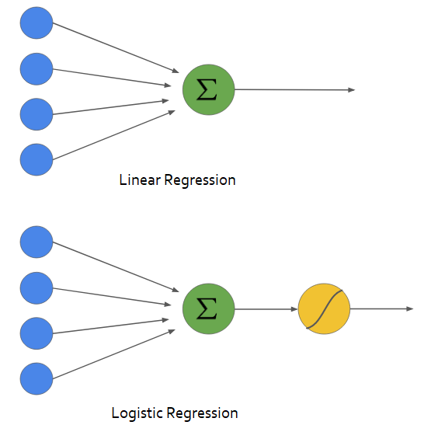

Slide 15
Logistic Regression
from sklearn.linear_model import LogisticRegression
lr = LogisticRegression()
lr.fit(X_train,Y_train)
Y_pred_lr = lr.predict(X_test)
Output accuracy
The accuracy score achieved using Logistic Regression is: 85.25 %

Slide 16
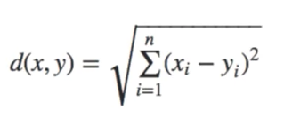
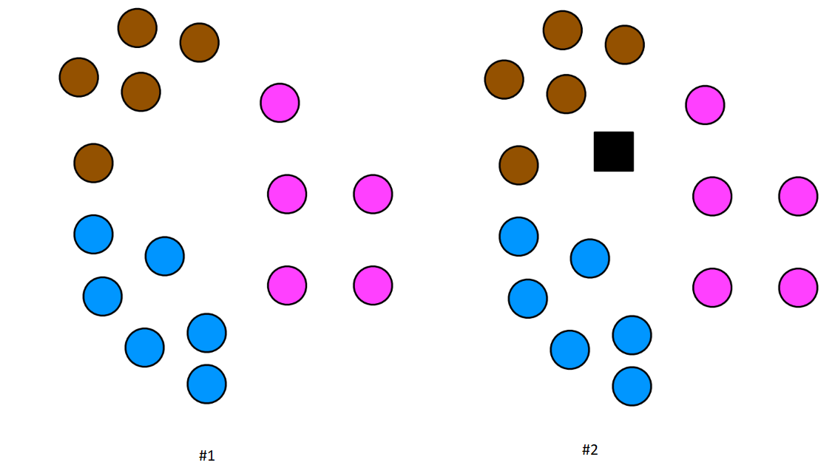
K-Nearest Neighbors(KNN)-
KNN is a non-probabilistic supervised learning algorithm i.e. it doesn’t produce the probability of membership of any data point rather KNN classifies the data on hard assignment, e.g the data point will either belong to 0 or 1.
KNN uses distance metrics in order to find similarities or dissimilarities.
Euclidean Distance:
Euclidean distance is one of the most used distance metric.

Slide 17
K Nearest Neighbors
from sklearn.neighbors import KNeighborsClassifier
knn = KNeighborsClassifier(n_neighbors=7)
knn.fit(X_train,Y_train)
Y_pred_knn=knn.predict(X_test)
Output accuracy
The accuracy score achieved using KNN is: 67.21 %

Slide 18
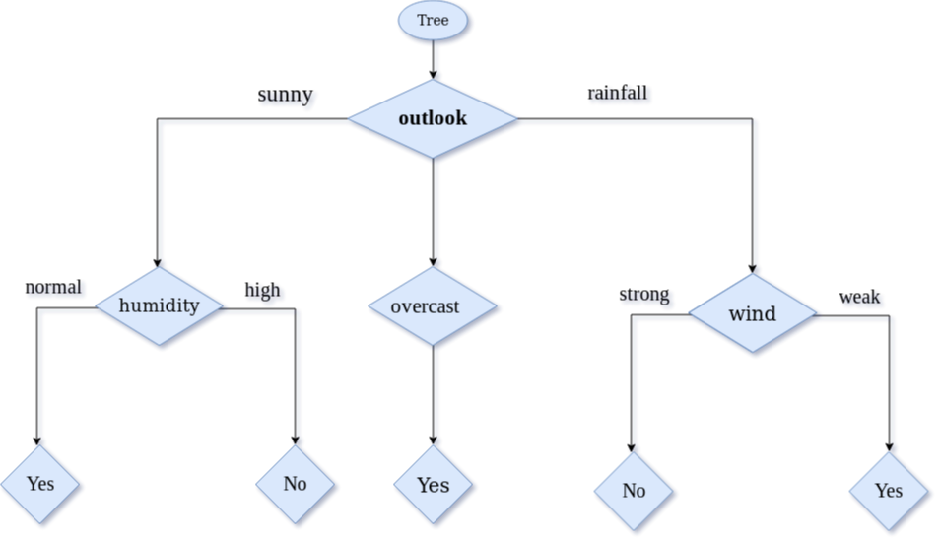
Decision Tree - Classification
Decision tree builds classification or regression models in the form of a tree structure. It breaks down a dataset into smaller and smaller subsets while at the same time an associated decision tree is incrementally developed. The final result is a tree with decision nodes and leaf nodes.

Slide 19


Entropy
Entropy is amount of information is needed to accurately describe the some sample. So if sample is homogeneous, means all the element are similar than Entropy is 0, else if sample is equally divided than entropy is maximum 1.
Gini index / Gini impurity
Gini index is measure of inequality in sample. It has value between 0 and 1. Gini index of value 0 means sample are perfectly homogeneous and all element are similar, whereas, Gini index of value 1 means maximal inequality among elements.

Slide 20
Decision Tree
from sklearn.tree import DecisionTreeClassifier
dt = DecisionTreeClassifier()
dt.fit(X_train,Y_train)
Y_pred_dt = dt.predict(X_test)
Output accuracy
The accuracy score achieved using Decision Tree is: 78.69 %

Slide 21
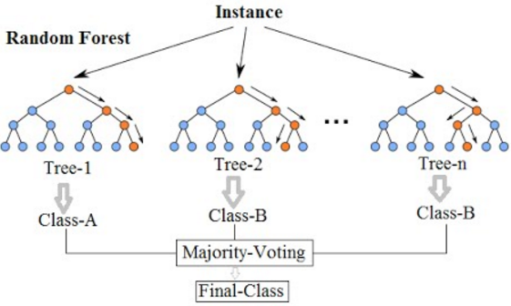
Ensembles - Random Forests:
Ensemble means Collection or group of things.
Ensemble learning is a machine learning technique that combines several base models in order to produce one optimal predictive model (powerful model).
Random forests (RF) construct many individual decision trees at training. Predictions from all trees are pooled to make the final prediction; the mode of the classes for classification or the mean prediction for regression. As they use a collection of results to make a final decision, they are referred to as Ensemble techniques.

Slide 22
Random Forest
from sklearn.ensemble import RandomForestClassifier
rf = RandomForestClassifier()
rf.fit(X_train,Y_train)
Y_pred_rf = rf.predict(X_test)
Output accuracy
The accuracy score achieved using Decision Tree is: 88.52 %

Slide 23
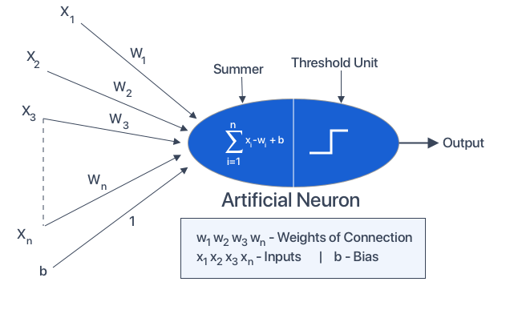
Neural Network
The term ‘Neural’ has origin from the human (animal) nervous system’s basic functional unit ‘neuron’ or nerve cells present in the brain and other parts of the human (animal) body.
A neural network is a group of algorithms that certify the underlying relationship in a set of data similar to the human brain.
The neural network helps to change the input so that the network gives the best result without redesigning the output procedure.

Slide 24
Activation function
Activation functions are an extremely important feature of the artificial neural networks. They basically decide whether a neuron should be activated or not. Whether the information that the neuron is receiving is relevant for the given information or should it be ignored.
Binary Step Function
It is defined as –
f(x) = 1, x>=0
= 0 x<0
Sigmoid
Sigmoid is a widely used activation function. It is of the form-
f(x)=1/(1+e^-x)
ReLU
The ReLU function is the Rectified linear unit. It is the most widely used activation function. It is defined as-
f(x)=max(0,x)

Slide 25
Neural Network
from keras.models import Sequential
from keras.layers import Dense
nn_model = Sequential()
nn_model.add(Dense(11,activation='relu',input_dim=13))
nn_model.add(Dense(1,activation='sigmoid'))
nn_model.compile(loss='binary_crossentropy',optimizer='adam',metrics=['accuracy'])
nn_model.fit(X_input,Y_input,epochs=300)
pred_nn = nn_model.predict(X_output)
Output accuracy
The accuracy score achieved using XGBoost is: 81.97 %

Slide 26
Model Evaluation
From the above metrics Random forest giving better accuracy so final model
will be built by using Random Forest
Model | Accuracy
Logistic Regression | 85.25
K Nearest Neighbors | 67.21
Decision Tree | 78.69
Random Forest | 88.52
Neural Network | 81.97

